Slide 1

Python Programming Language

Slide 2
Python
Python is a simple, easy to learn, powerful, high level and object-oriented programming language.
Python is an interpreted scripting language also. Guido Van Rossum is known as the founder of python programming.
Python is a general purpose, dynamic, high level and interpreted programming language.
It supports Object Oriented programming approach to develop applications. It is simple and easy to learn and provides lots of high-level data structures.
Python is easy to learn yet powerful and versatile scripting language which makes it attractive for Application Development.
Python's syntax and dynamic typing with its interpreted nature, makes it an ideal language for scripting and rapid application development.

Slide 3
Cont’d
Python supports multiple programming pattern, including object oriented, imperative and functional or procedural programming styles.
Python is not intended to work on special area such as web programming. That is why it is known as multipurpose because it can be used with web, enterprise, 3D CAD etc.
We don't need to use data types to declare variable because it is dynamically typed so we can write a=10 to assign an integer value in an integer variable.
Python makes the development and debugging fast because there is no compilation step included in python development and edit-test-debug cycle is very fast.

Slide 4
Python Applications
Python is known for its general purpose nature that makes it applicable in almost each domain of software development.
Python as a whole can be used in any sphere of development.
Here, we are specifying applications areas where python can be applied.
Web Applications
We can use Python to develop web applications. It provides libraries to handle internet protocols such as HTML and XML, JSON, Email processing, request, beautifulSoup, Feedparser etc.
It also provides Frameworks such as Django, Pyramid, Flask etc to design and delelop web based applications. Some important developments are: PythonWikiEngines, Pocoo, PythonBlogSoftware etc.

Slide 5
Python Applications
Desktop GUI Applications
Python provides Tk GUI library to develop user interface in python based application. Some other useful toolkits wxWidgets, Kivy, pyqt that are useable on several platforms. The Kivy is popular for writing multi-touch applications.
Software Development
Python is helpful for software development process. It works as a support language and can be used for build control and management, testing etc.
Scientific and Numeric
Python is popular and widely used in scientific and numeric computing. Some useful library and package are SciPy, Pandas, IPython etc. SciPy is group of packages of engineering, science and mathematics.
Business Applications
Python is used to build Bussiness applications like ERP and e-commerce systems. Tryton is a high level application platform.

Slide 6
Console Based Application
We can use Python to develop console based applications. For example: Ipython
Audio or Video based Applications
Python is awesome to perform multiple tasks and can be used to develop multimedia applications. Some of real applications are: TimPlayer, cplay
3D CAD Applications
To create CAD application. Fandango is a real application which provides full features of CAD.
Enterprise Applications
Python can be used to create applications which can be used within an Enterprise or an Organization. Some real time applications are: OpenErp, Tryton, Picalo etc.
Applications for Images
Using Python several application can be developed for image. Applications developed are: VPython, Gogh, imgSeek etc.

Slide 7
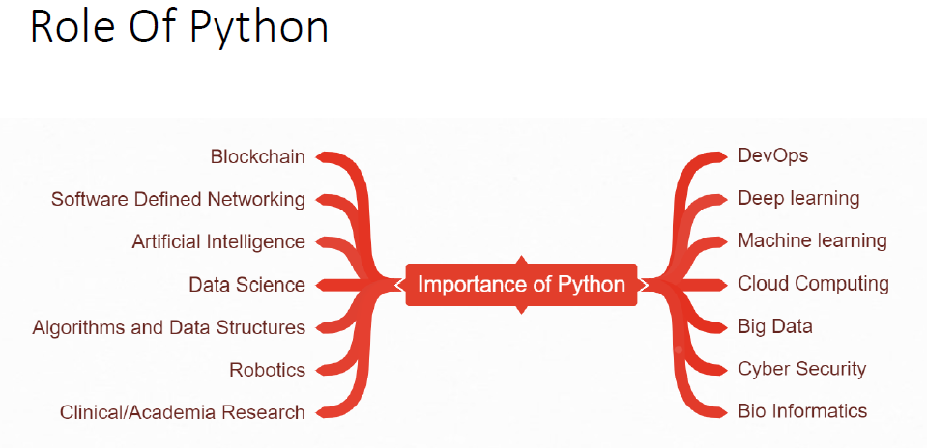

Slide 8
Python provides us the two ways to run a program:
Using Interactive interpreter prompt
Using a script file
Python provides us the feature to execute the python statement one by one at the interactive prompt.
It is preferable in the case where we are concerned about the output of each line of our python program.
However, we can not write the code every-time on the terminal/console.
We need to write our code into a file which can be executed later. For this purpose, open an editor like notepad, create a file named first.py (python used .py extension) and write the Python code

Slide 9
Python Editors
JetBrains provides the most popular and a widely used cross-platform IDE PyCharm to run the python programs.
Spider is python editor that comes with Anaconda distribution.

Slide 10
Anaconda Distribution
The Most Trusted Distribution for Data Science.
Anaconda® is a package manager, an environment manager, a Python/R data science distribution, and a collection of over 1,500+ open source packages.
Anaconda is free and easy to install.
Packages available in Anaconda
Over 200 packages are automatically installed with Anaconda.
Over 2000 additional open source packages (including R) can be individually installed from the Anaconda repository with the conda install command.
Thousands of other packages are available from Anaconda Cloud.
You can download other packages using the pip install command that is installed with Anaconda.
Download Anaconda from : https://www.anaconda.com/distribution/

Slide 11
Python Variables
Variable is a name which is used to refer memory location. Variable also known as identifier and used to hold value.
In Python, we don't need to specify the type of variable because Python is a type infer language and smart enough to get variable type.
Variable names can be a group of both letters and digits, but they have to begin with a letter or an underscore.
It is recommended to use lowercase letters for variable name. Rahul and rahul both are two different variables.

Slide 12
Identifier Naming
Variables are the example of identifiers. An Identifier is used to identify the literals used in the program.
The rules to name an identifier are given below.
The first character of the variable must be an alphabet or underscore ( _ ).
All the characters except the first character may be an alphabet of lower-case(a-z), upper-case (A-Z), underscore or digit (0-9).
Identifier name must not contain any white-space, or special character (!, @, #, %, ^, &, *).
Identifier name must not be similar to any keyword defined in the language.
Identifier names are case sensitive for example my name, and MyName is not the same.
Examples of valid identifiers : a123, _n, n_9, etc.
Examples of invalid identifiers: 1a, n%4, n 9, etc.

Slide 13
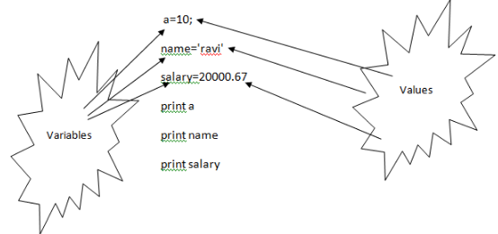
Declaring Variable and Assigning Values
Python does not bound us to declare variable before using in the application. It allows us to create variable at required time.
We don't need to declare explicitly variable in Python. When we assign any value to the variable that variable is declared automatically.

Slide 14
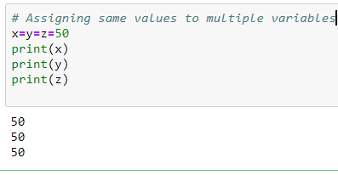
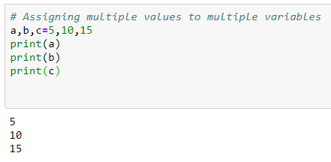
Multiple Assignment
Python allows us to assign a value to multiple variables in a single statement which is also known as multiple assignment.
We can apply multiple assignments in two ways either by
assigning a single value to multiple variables
or assigning multiple values to multiple variables

Slide 15
Python Data Types
Variables can hold values of different data types.
Every value in Python has a datatype. Since everything is an object in Python programming, data types are actually classes and variables are instance (object) of these classes.
Python is a dynamically typed language hence we need not define the type of the variable while declaring it. The interpreter implicitly binds the value with its type.
Python enables us to check the type of the variable used in the program. Python provides us the type() function which returns the type of the variable passed.
Consider the following example to define the values of different data types and checking its type.

Slide 16
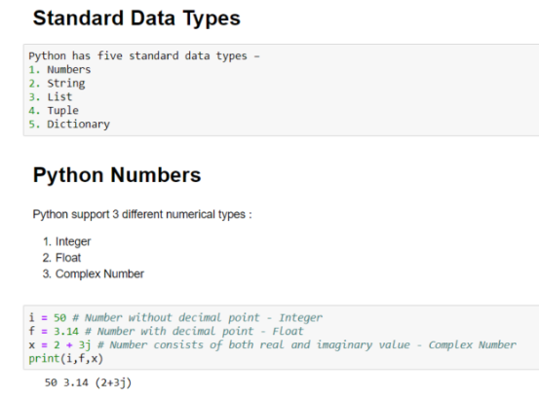

Slide 17
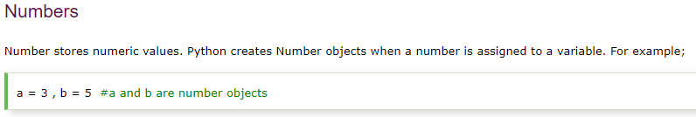
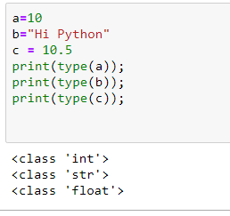

Slide 18

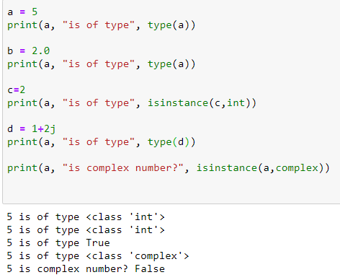
-Complex numbers are written in the form, x + yj, where x is the real part and y is the imaginary part.
-We can use the type() function to know which class a variable or a value belongs to ---
and isinstance() function to check if it belongs to a particular class.

Slide 19
String Data Type
The string can be defined as the sequence of characters represented in the quotation marks. In python, we can use single, double, or triple quotes to define a string.
String handling in python is a straightforward task since there are various inbuilt functions and operators provided.
In the case of string handling, the operator + is used to concatenate two strings as the operation "hello"+" python" returns "hello python".
The operator * is known as repetition operator as the operation "Python " *2 returns "Python Python ".

Slide 20
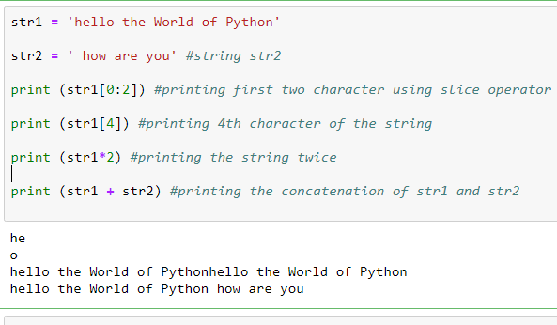

Slide 21
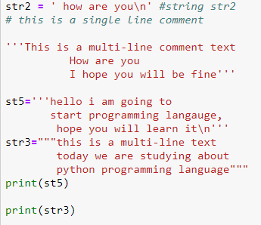

Slide 22
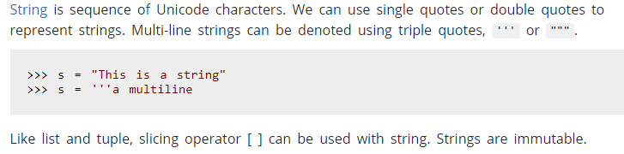
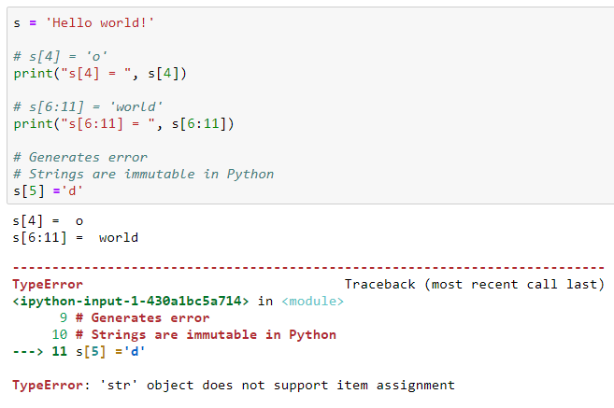

Slide 23
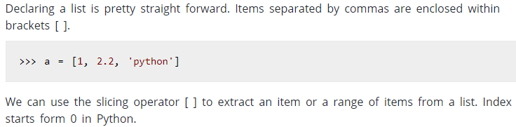
Python List
Lists are similar to arrays in C.
The concatenation operator (+) and repetition operator (*) works with the list in
the same way as they were working with the strings.

Slide 24
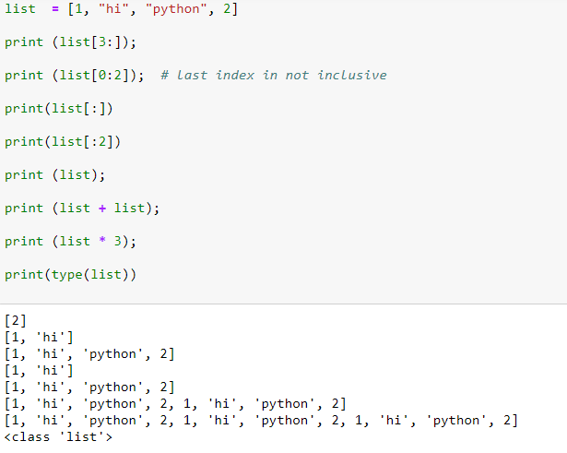

Slide 25
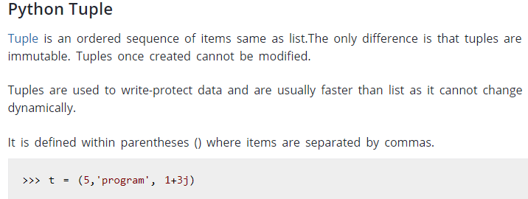
A tuple is a read-only data structure as we can't modify the size and value of the items of a tuple.

Slide 26
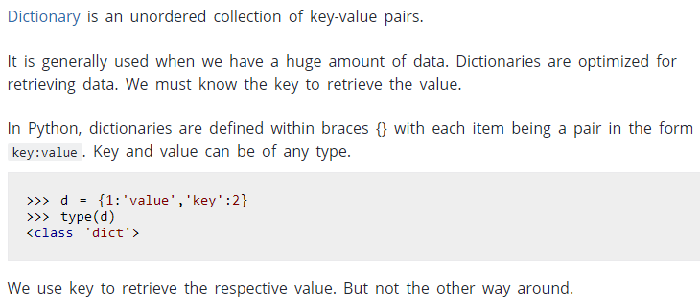
Python Dictionary

Slide 27
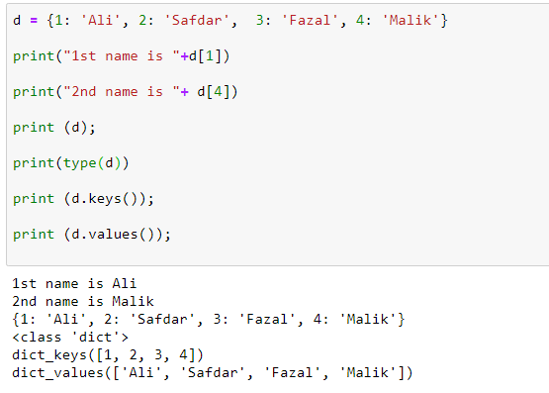

Slide 28
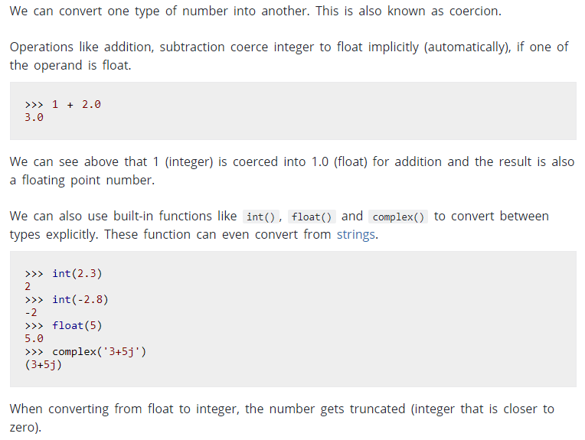
Type Conversion

